Slide 1
COASTAL FUTURES
Building Capacity for Data-Driven Adaptation
in Rural Coastal Communities
Social and Decision Analytics Division (SDAD)
UVA Environmental Resilience Institute
Notes:
UVA Environmental Resilience Institute [Department of Environmental Sciences, UVA Engineering, Network Systems Science and Advanced Computing (NSSAC)]

Slide 2
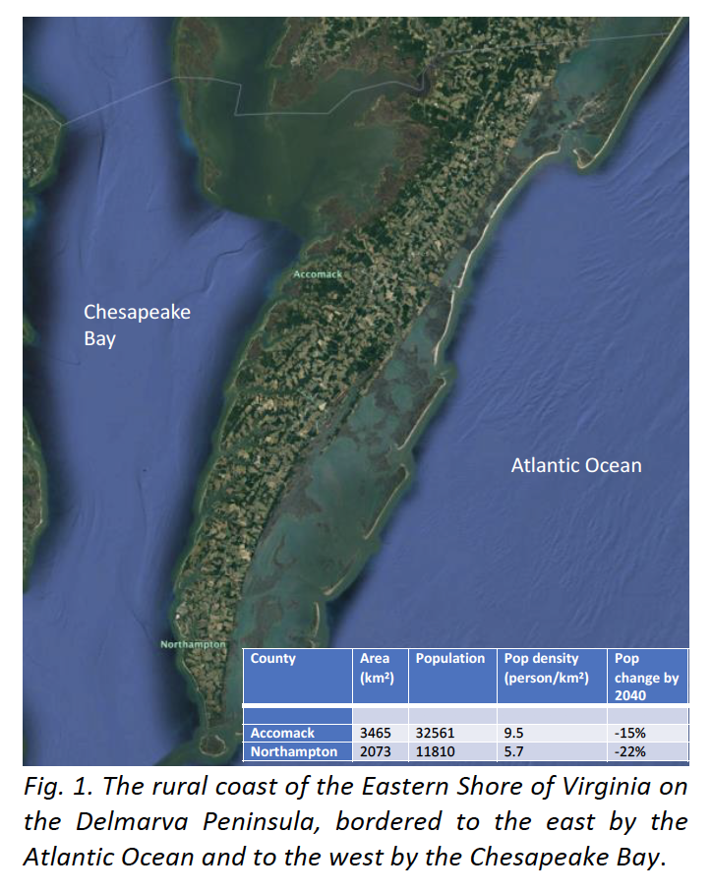
Goal: Developing tools and build capacity for rural coastal communities to face challenges form climate risks: saltwater intrusion from sea level rise and storm flooding.
Research Questions:
How do coastal flooding and groundwater salinization impact crop production and coastal habitats?
Where are climate risks and inequities most pronounced now and in the future?
How will water security change across different communities? How does this change under different adaptation policies?

Slide 3
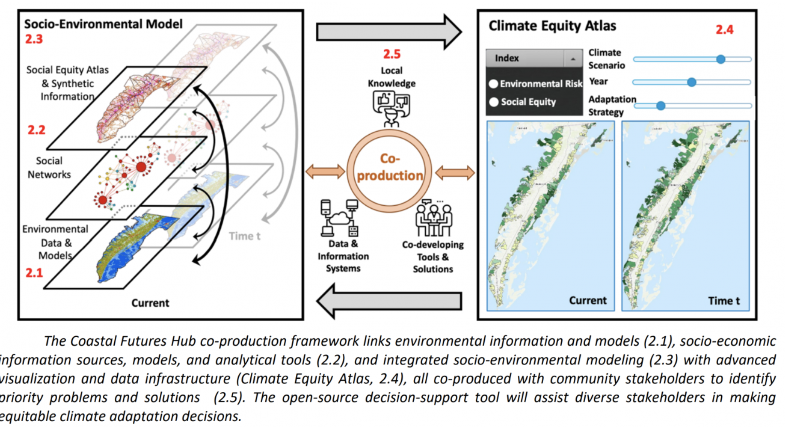

Slide 4
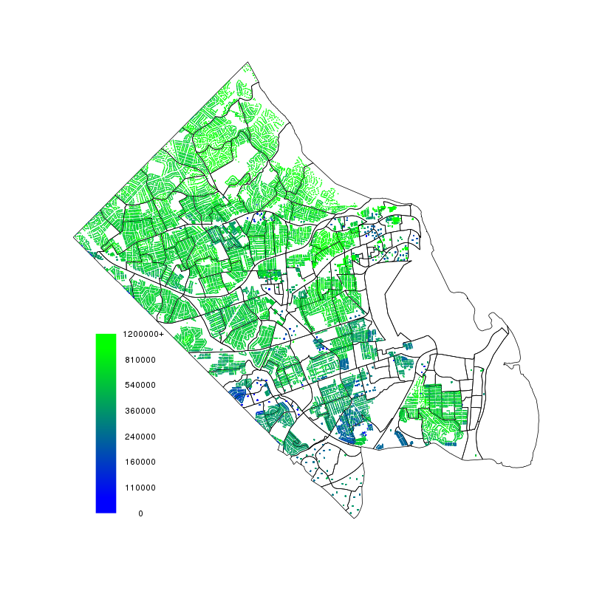
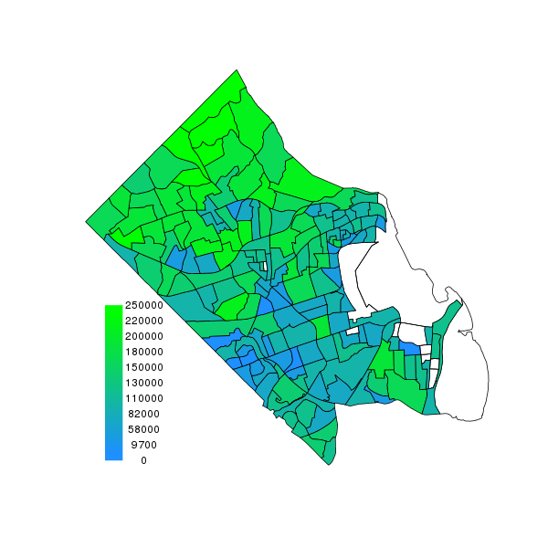
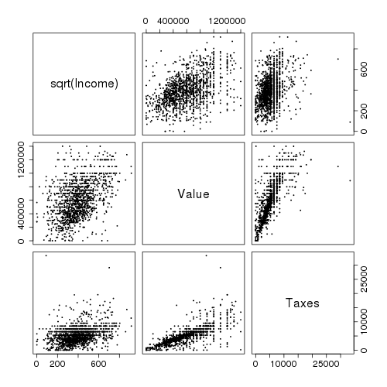
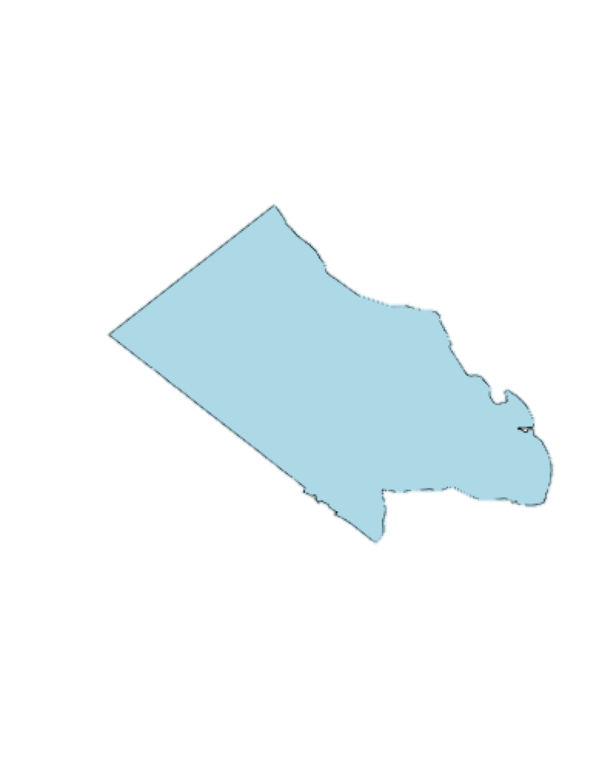
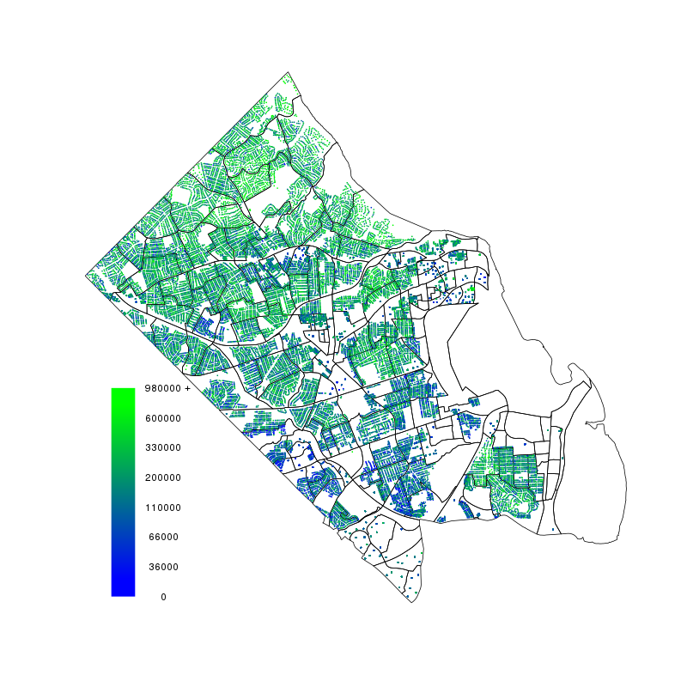
Impute a synthetic population by combining multiple
sources of administrative and survey data
Local Data
housing price
tax amount from real estate tax assessments
ACS
Income summary
- by block group
ACS Microdata
housing price
tax amount
income
- county sample
Household level Imputation
housing price
tax amount
income
Notes:
Inputs into microscale simulation models
Reaggregation at new geographies (e.g. block group => political or school boundaries)

Slide 5
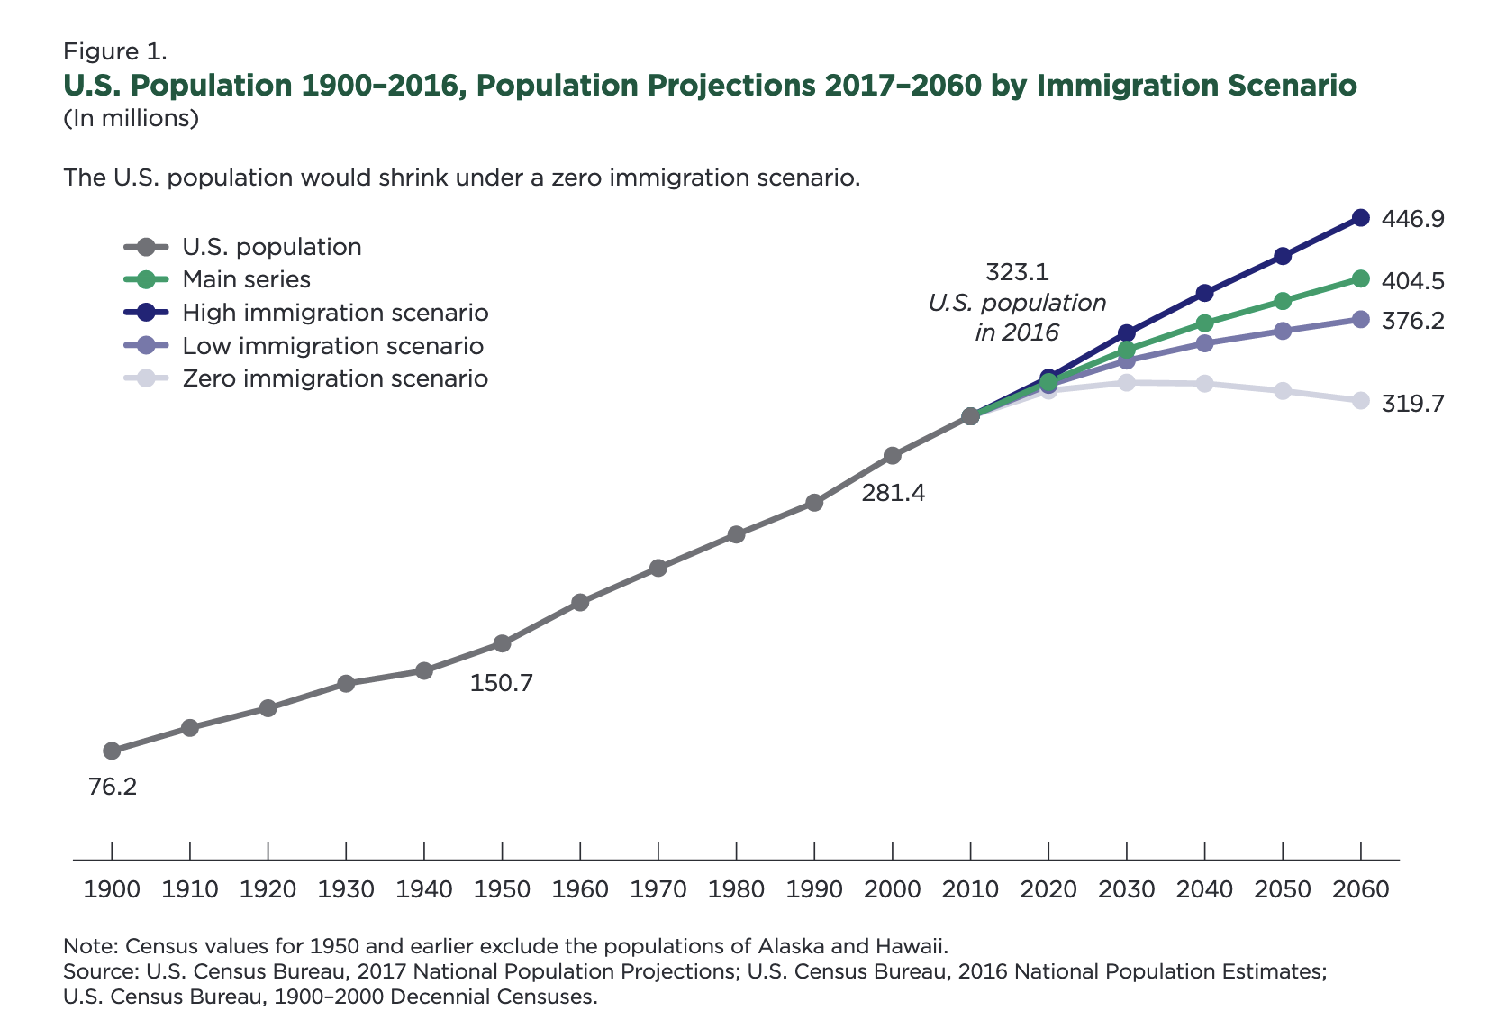
Learn about population projections using cohort components (and other methods).
Create decadal projections of ESVA as inputs into scenario analysis under different climate outcomes and adaptation policies.
Notes:
Population projections using cohort-component method from Census -- under multiple scenarios

Slide 6
Summer Tasks
Project background and literature review
Data discovery and inventory to characterize households and farms in ESVA; data acquisition, cleaning, linking
Help to construct a synthetic population for Accomack and Northampton counties using Iterative Proportional Fitting
Apply demographic projections to predict how these populations will change over the next several decades

